Slide 1
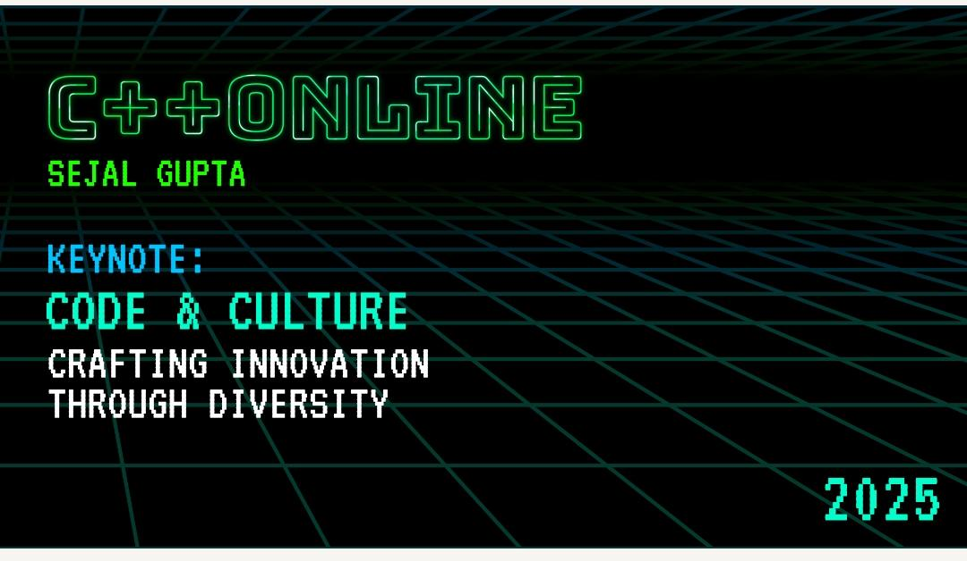

Slide 2
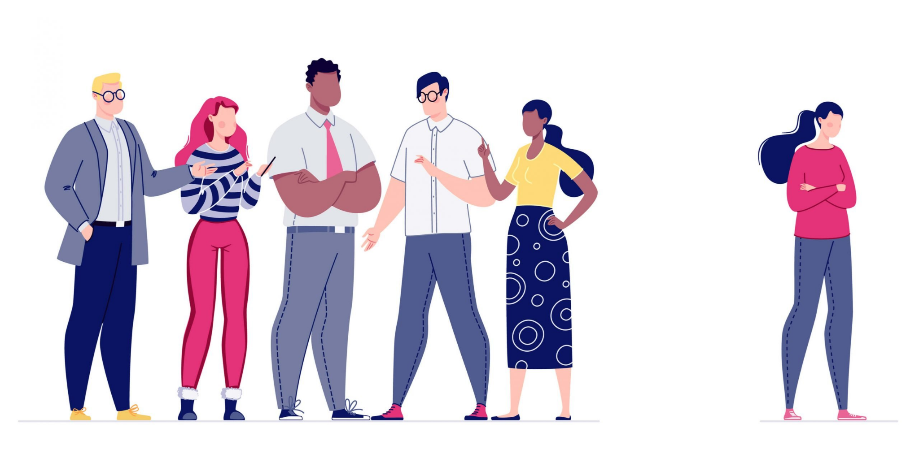
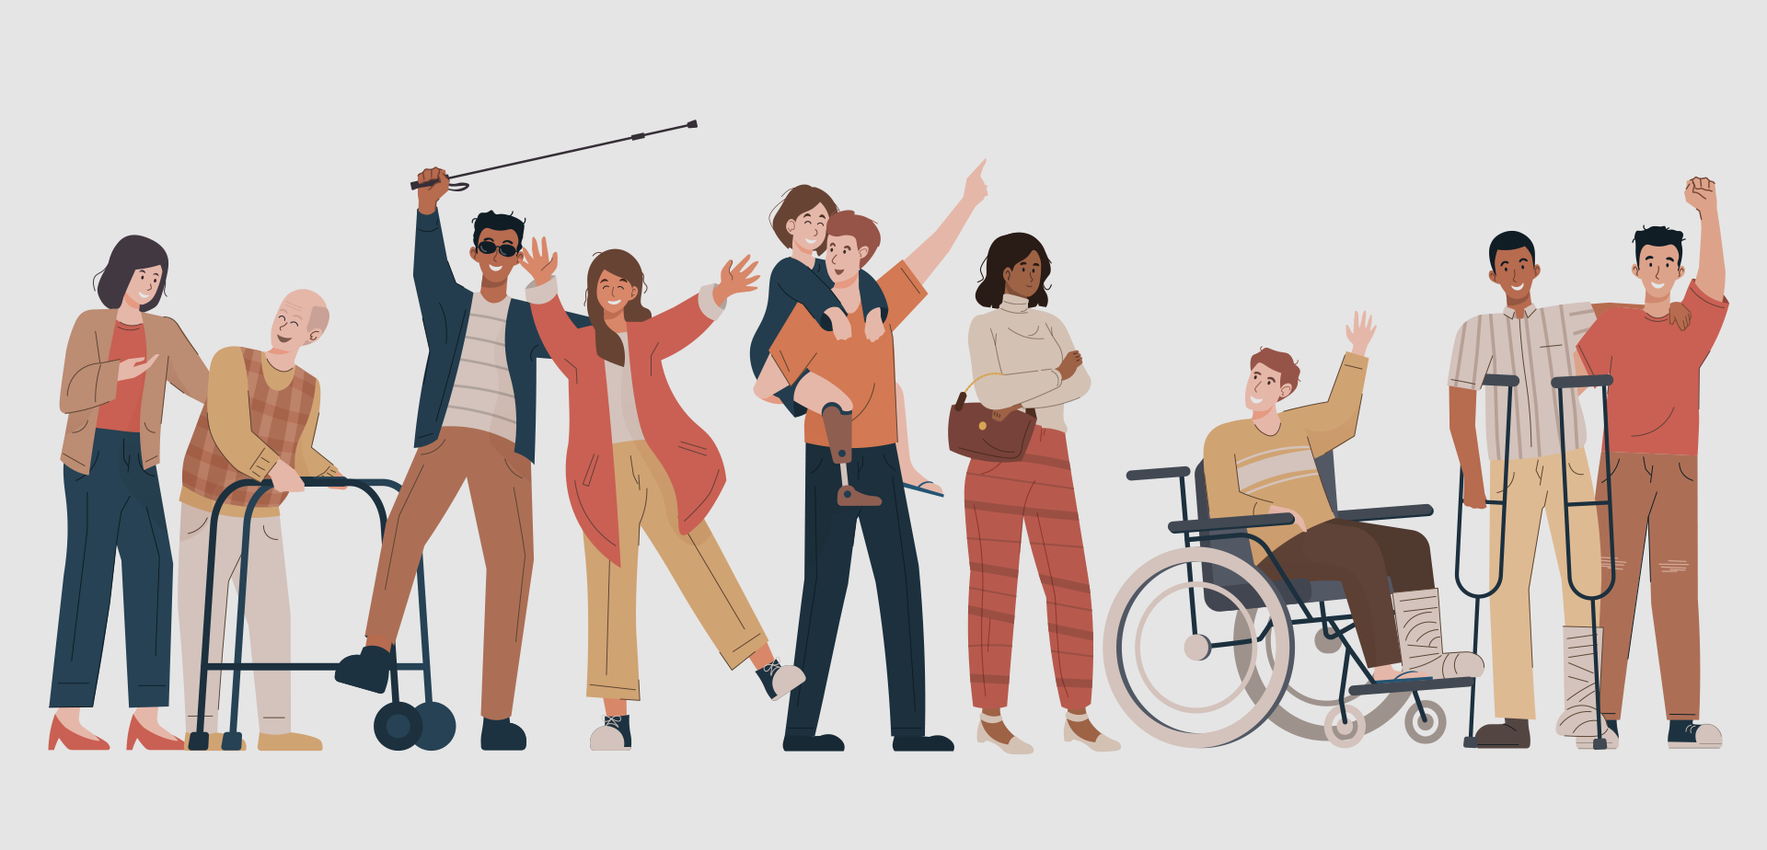
Have you ever felt excluded
because of how something was designed?

Slide 3



CODE AND CULTURE
Have you ever felt lost in a foreign land where you can’t make sense of sign boards or maps?

Slide 4

CODE AND CULTURE
Can you help me figure out if this milk carton is expired or not?
Expiry: 01/03/2025

Slide 5
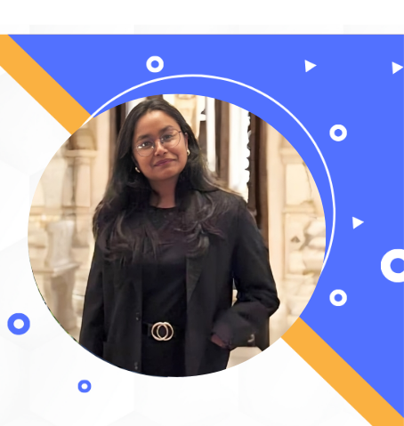
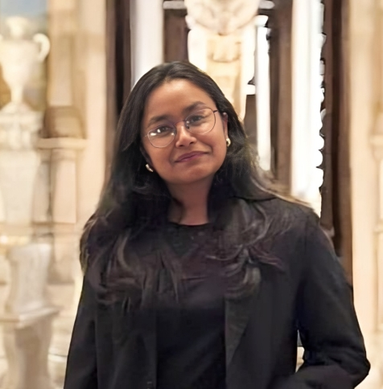
CODE & CULTURE
Crafting Innovation Through Diversity
SEJAL GUPTA (She/Her)
Software Developer, India
Founder @ WIT++: Women in Tech
Enthusiastic about Green Computing
Tea Sommelier☕;Blogger📝

Slide 6
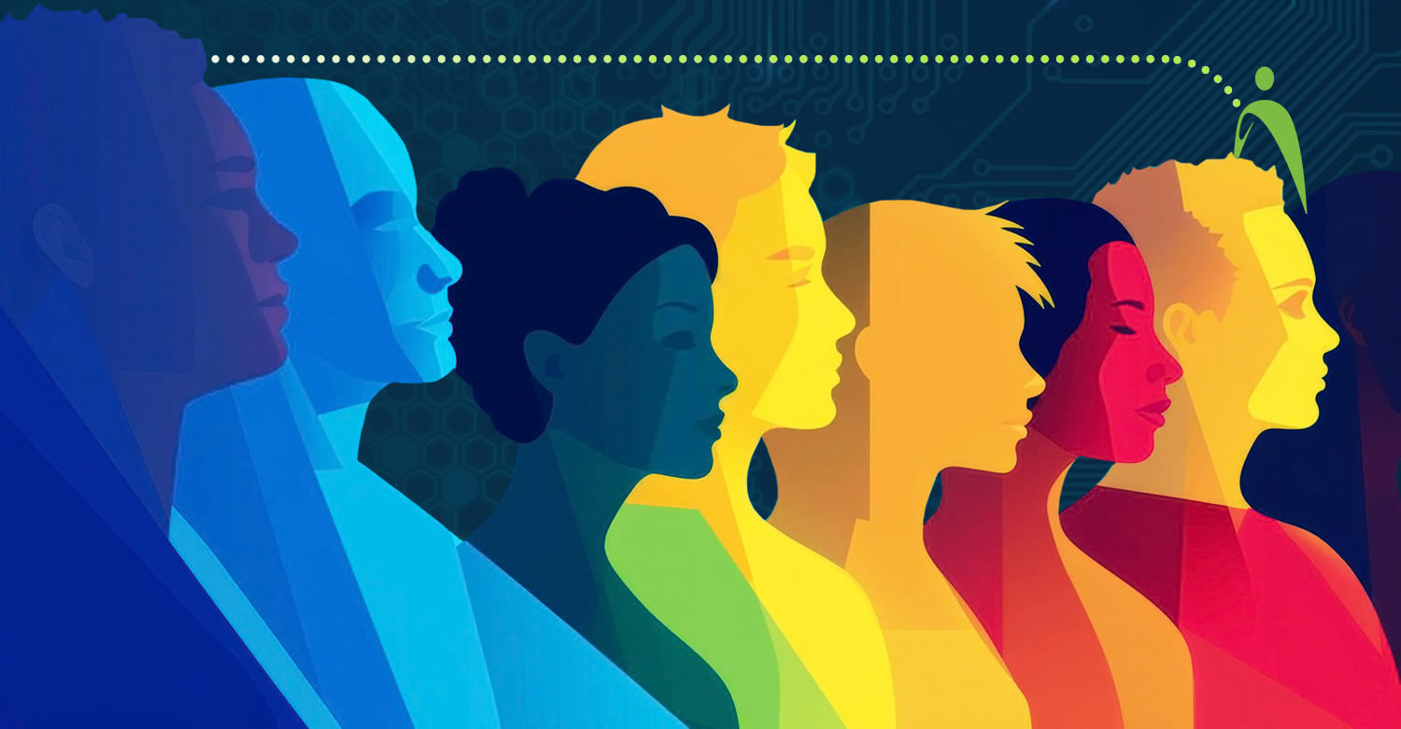
Disclaimer
The thoughts and views expressed solely represent my opinion. The content in no way represents the views and opinions of the people, institutions, or organization that I may or may not be associated with in professional and personal capacity, unless explicitly stated.

Slide 7
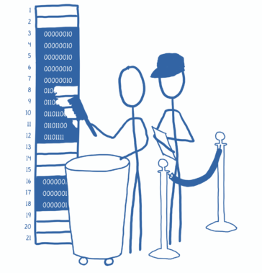
Contents
Agenda
What is Inclusion?
Why should I care about Inclusion?
Case Studies on Inclusion
How can I bring inclusion through my code?
D&I in Workplace
Best Practices & Q/A

Slide 8
CODE AND CULTURE
What is Inclusion?
Treating everyone the same is the best way to be inclusive.

Slide 9
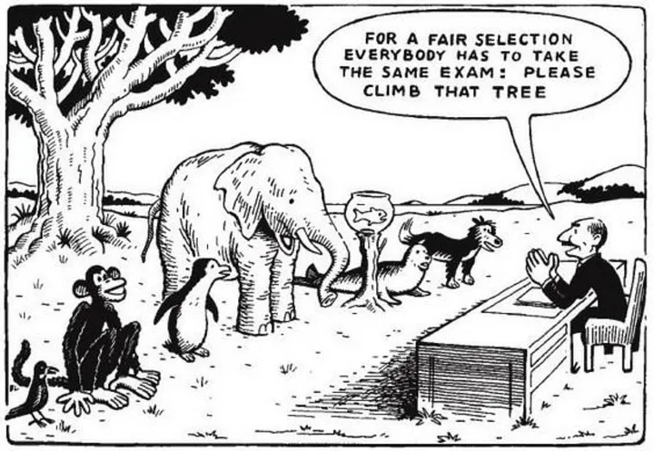

Slide 10
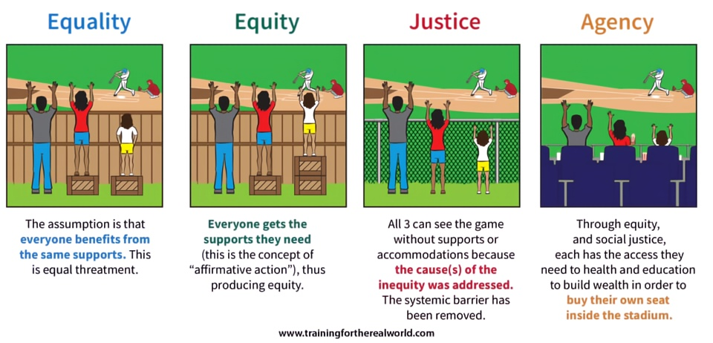

Slide 11

CODE AND CULTURE
What is Inclusion?
Inclusion is fostering a culture that embraces differences in backgrounds, perspectives, and identities
Treating everyone the same is the best way to be inclusive.

Slide 12
CODE AND CULTURE
Inclusion
Geographic Inclusion
Linguistic Inclusion
Neurodiversity
Equity
Accessibility
Diversity
Economic Inclusion
Cultural Inclusion
Notes:
There are many aspects of inclusion. equity, belonging, cultural competency, linguistic inclusion, economic inclusion, neurodiversity, geographic inclusion.. to name a few. I’ll focus on two of these flavors: accessbility and diversity

Slide 13






Slide 14



Do not edit
How to change the design
Which one(s) of these Netflix series have you watched or heard of?
Presenting with animations, GIFs or speaker notes? Enable our Chrome extension
Notes:
📣 This is Slido interaction slide, please don't delete it. ✅ Click on 'Present with Slido' and the poll will launch automatically when you get to this slide.

Slide 15

CODE AND CULTURE
The Problem
Until 2016, Netflix struggled to gain traction globally

Slide 16

CODE AND CULTURE
Key Reason?
Lack of representation in their content creation teams, which were dominated by a narrow demographic

Slide 17
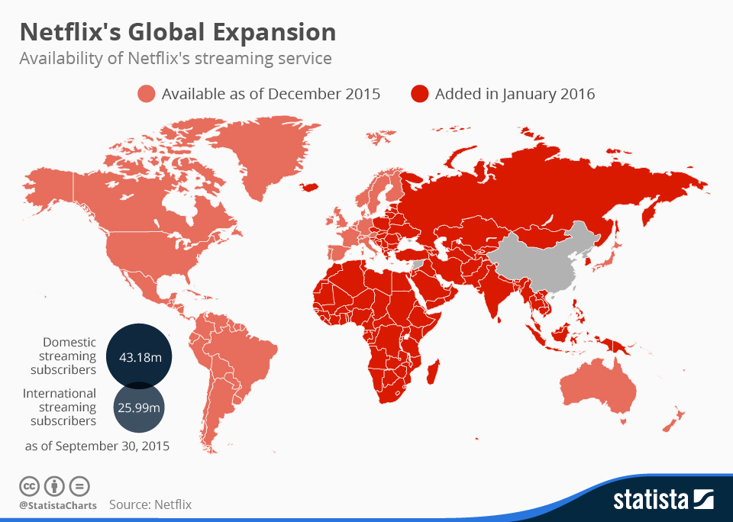
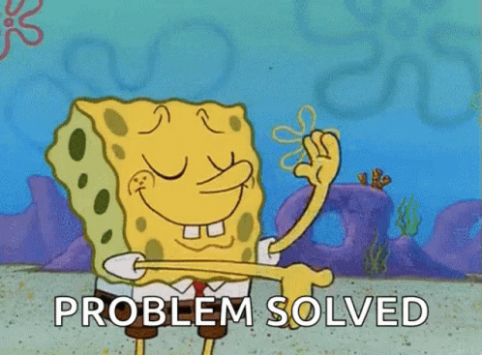
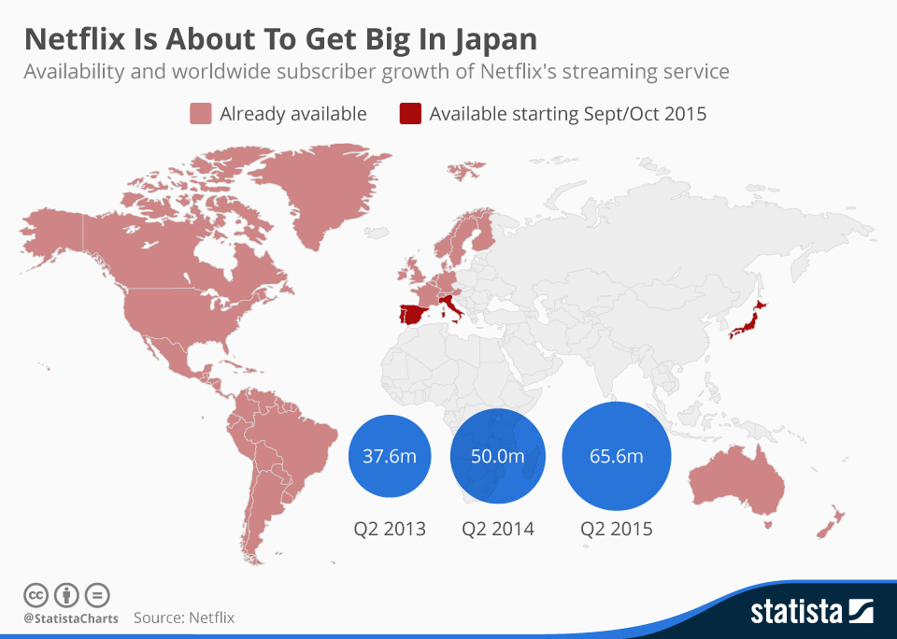
Diverse stories connect the world
Solution^{[1]}: Consciously hired diverse talent
Results^{[1]}:
$15 billion (~30%) Increase in Revenue
Gained 47.3 Million international subs in 2 years

Slide 18
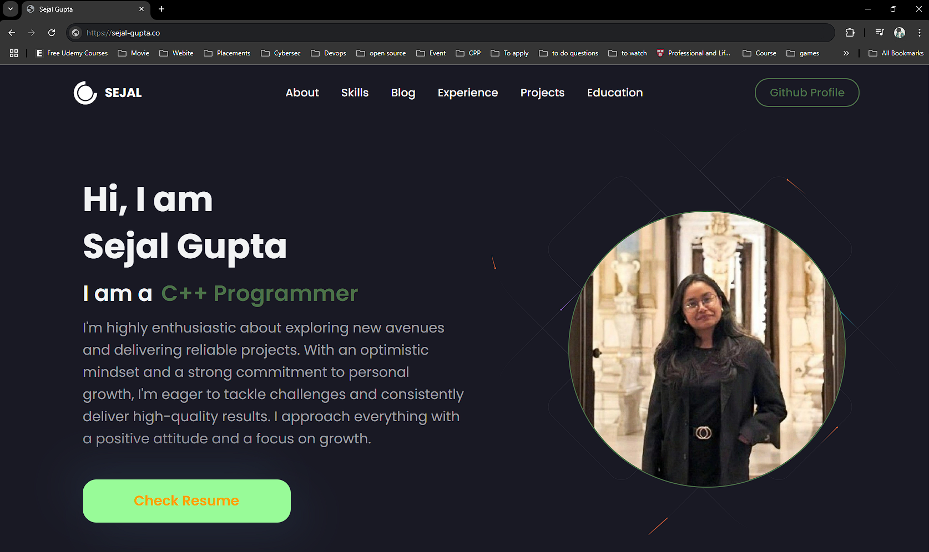
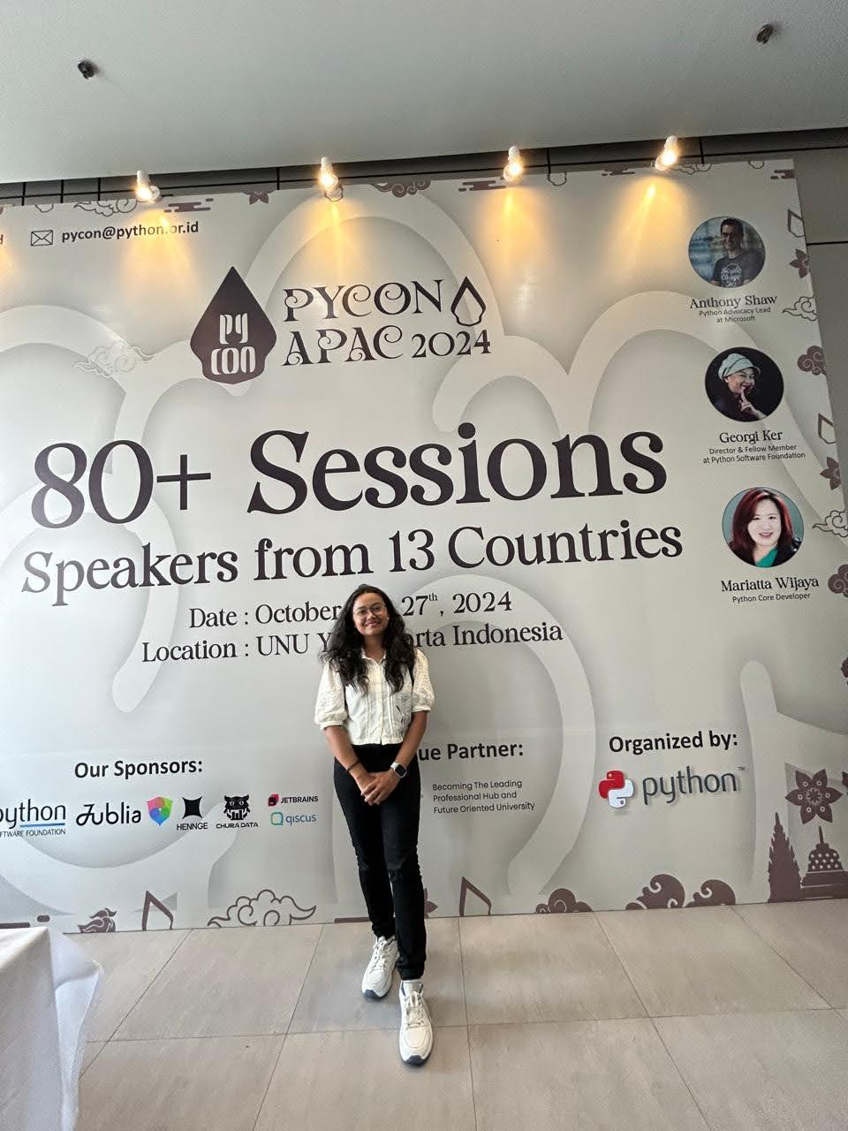

Slide 19
CODE AND CULTURE
8% of men = ~322 million men are colorblind^{[3]}
0.5% of women = ~20 million women are colorblind^{[3]}

Slide 21
CODE AND CULTURE
8% of men = ~322 million men are colorblind^{[3]}
0.5% of women = ~20 million women are colorblind^{[3]}
28% = ~2.2 billion globally, live with some form of vision impairment^{[3]}
“An estimated 1.3 billion people, i.e. 16% of the global population, currently experience significant form of disability” ^{[2]}

Slide 22
CODE AND CULTURE
Why is Inclusion in Tech Important?
Notes:
WHY I SHOULD CARE AS A DEVELOPER

Slide 23
CODE AND CULTURE
Why Should I Care About Inclusion as a Developer?
Notes:
WHY I SHOULD CARE AS A DEVELOPER

Slide 24
CODE AND CULTURE
Women hold 25% of computing jobs, despite representing 49.6% globally^{[4]}
Less than 5% of tech workers globally openly identify as LGBTQIA+ ^{[5]}
Black professionals hold 2% of tech jobs, despite making up 6-10% of population in UK, France^{[6]}
1–3% of global tech workers disclose disabilities compared to 16% of the global population living with disabilities^{[2],[7]}
Notes:
“Let’s build a future where everyone has a seat at the table."
Speaker notes:
"According to a 2023 report by the Bureau of Labor Statistics:
Only 26% of computing-related jobs are held by women.
Black professionals hold just 7% of tech jobs, despite making up 13% of the U.S. population.
Latinx professionals hold only 8% of tech jobs, while representing 18% of the population.
And for individuals with disabilities, representation drops to less than 5% in the tech workforce."
Connecting the Dots:
"These stats aren’t just numbers—they’re missed opportunities. If we’re building tech for everyone, shouldn’t our teams look like everyone?"
Setting the Stage:
"Today, we’re talking about why diversity in software engineering isn’t just nice to have—it’s a must.—it’s a necessity for innovation, growth, and creating products that truly meet the needs of everyone. We’ll explore the challenges we face, the progress being made, and most importantly, what each of us can do to build a more inclusive future in tech."

Slide 25
CODE AND CULTURE
“If we are building tech for everyone,
shouldn’t our teams reflect everyone?”

Slide 26
CODE AND CULTURE
The Problem
Many tech products aren’t designed for people with disabilities in mind.

Slide 27
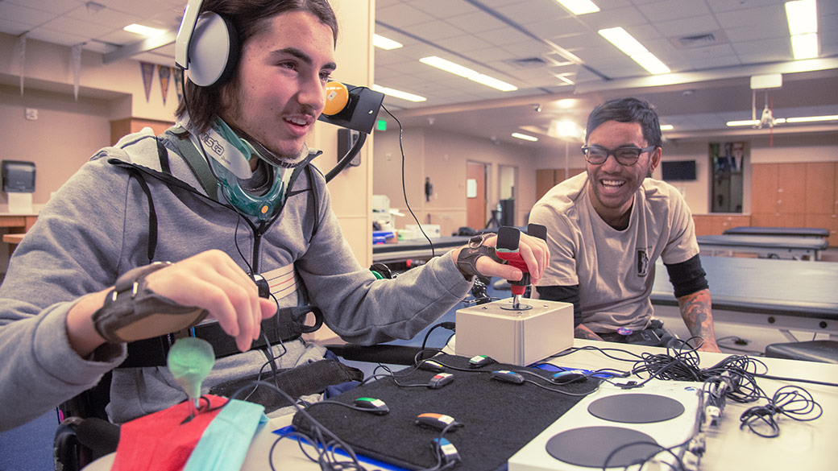

Case Study: Inclusive Design for Accessibility
Notes:
Challenge: Tech products often exclude people with disabilities.
Solution: Diverse teams, including engineers with disabilities, designed the Xbox Adaptive Controller.
Outcome: A groundbreaking product that empowers gamers with limited mobility.
Let’s start with Microsoft—a company that’s leading the way in inclusive design.
Here’s the challenge they faced: Many tech products weren’t designed with people with disabilities in mind. This meant that a significant portion of the population was being left out.
So, what did Microsoft do? They formed diverse teams, including engineers with disabilities, to tackle this problem head-on. One of their most iconic innovations is the Xbox Adaptive Controller.
This controller was designed specifically for gamers with limited mobility. It features customizable inputs, compatibility with external devices, and a user-friendly design.
The result? A groundbreaking product that’s been praised for its inclusivity and innovation.
The key takeaway here is simple: Diverse teams create products that work for everyone. By including people with disabilities in the design process, Microsoft didn’t just solve a problem—they set a new standard for accessibility in tech." A diverse team considers edge cases that a homogeneous group might overlook, leading to products that cater to a wider audience.

Slide 28
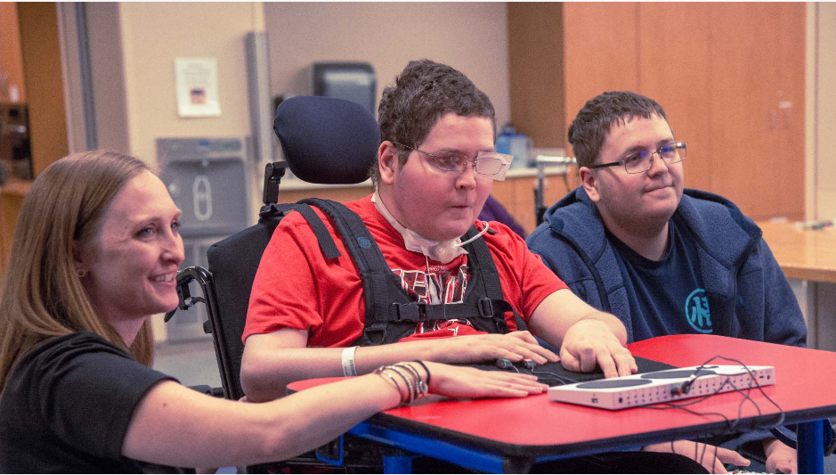
Case Study: Inclusive Design for Accessibility
Notes:
Challenge: Tech products often exclude people with disabilities.
Solution: Diverse teams, including engineers with disabilities, designed the Xbox Adaptive Controller.
Outcome: A groundbreaking product that empowers gamers with limited mobility.
Let’s start with Microsoft—a company that’s leading the way in inclusive design.
Here’s the challenge they faced: Many tech products weren’t designed with people with disabilities in mind. This meant that a significant portion of the population was being left out.
So, what did Microsoft do? They formed diverse teams, including engineers with disabilities, to tackle this problem head-on. One of their most iconic innovations is the Xbox Adaptive Controller.
This controller was designed specifically for gamers with limited mobility. It features customizable inputs, compatibility with external devices, and a user-friendly design.
The result? A groundbreaking product that’s been praised for its inclusivity and innovation.
The key takeaway here is simple: Diverse teams create products that work for everyone. By including people with disabilities in the design process, Microsoft didn’t just solve a problem—they set a new standard for accessibility in tech." A diverse team considers edge cases that a homogeneous group might overlook, leading to products that cater to a wider audience.

Slide 29

Case Study: Inclusive Design for Accessibility
Notes:
Challenge: Tech products often exclude people with disabilities.
Solution: Diverse teams, including engineers with disabilities, designed the Xbox Adaptive Controller.
Outcome: A groundbreaking product that empowers gamers with limited mobility.
Let’s start with Microsoft—a company that’s leading the way in inclusive design.
Here’s the challenge they faced: Many tech products weren’t designed with people with disabilities in mind. This meant that a significant portion of the population was being left out.
So, what did Microsoft do? They formed diverse teams, including engineers with disabilities, to tackle this problem head-on. One of their most iconic innovations is the Xbox Adaptive Controller.
This controller was designed specifically for gamers with limited mobility. It features customizable inputs, compatibility with external devices, and a user-friendly design.
The result? A groundbreaking product that’s been praised for its inclusivity and innovation.
The key takeaway here is simple: Diverse teams create products that work for everyone. By including people with disabilities in the design process, Microsoft didn’t just solve a problem—they set a new standard for accessibility in tech." A diverse team considers edge cases that a homogeneous group might overlook, leading to products that cater to a wider audience.

Slide 30
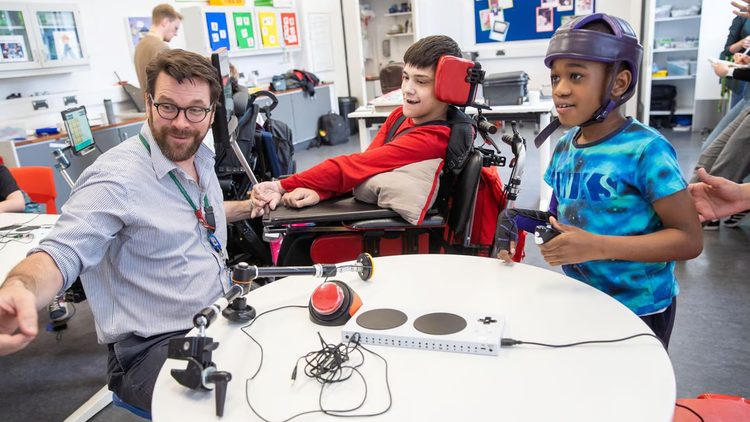
Case Study: Inclusive Design for Accessibility
Notes:
Challenge: Tech products often exclude people with disabilities.
Solution: Diverse teams, including engineers with disabilities, designed the Xbox Adaptive Controller.
Outcome: A groundbreaking product that empowers gamers with limited mobility.
Let’s start with Microsoft—a company that’s leading the way in inclusive design.
Here’s the challenge they faced: Many tech products weren’t designed with people with disabilities in mind. This meant that a significant portion of the population was being left out.
So, what did Microsoft do? They formed diverse teams, including engineers with disabilities, to tackle this problem head-on. One of their most iconic innovations is the Xbox Adaptive Controller.
This controller was designed specifically for gamers with limited mobility. It features customizable inputs, compatibility with external devices, and a user-friendly design.
The result? A groundbreaking product that’s been praised for its inclusivity and innovation.
The key takeaway here is simple: Diverse teams create products that work for everyone. By including people with disabilities in the design process, Microsoft didn’t just solve a problem—they set a new standard for accessibility in tech." A diverse team considers edge cases that a homogeneous group might overlook, leading to products that cater to a wider audience.

Slide 31

CODE AND CULTURE
Key Takeaway
Diverse teams has the power to create more inclusive and user-friendly product!

Slide 32
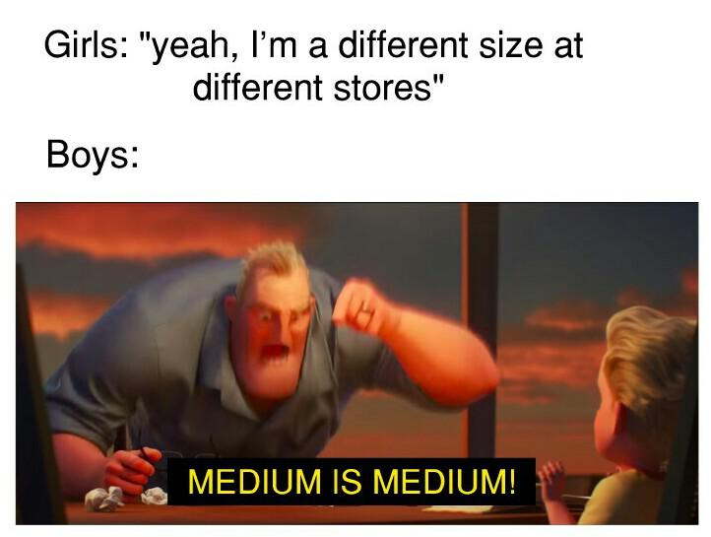

Slide 33

CODE AND CULTURE
The Problem
Many algorithms and softwares do not test for Inclusivity.

Slide 34
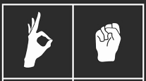
Case Study: YouTube’s Auto-Muting Algorithm
YouTube’s auto-detection for silent videos mistakenly muted sign language videos, assuming they contained “no content.”

Slide 35

CODE AND CULTURE
Key Takeaway
Inclusivity in tech is not just “beneficial” but essential for true global user engagement.

Slide 36
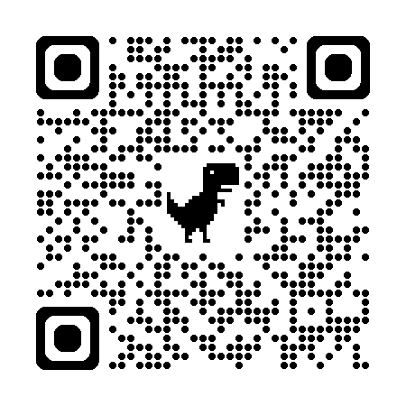
https://sejal-g.github.io/CPP_Online/

Slide 37

Do not edit
How to change the design
Did you find any problem navigating this form?
Presenting with animations, GIFs or speaker notes? Enable our Chrome extension
Notes:
📣 This is Slido interaction slide, please don't delete it. ✅ Click on 'Present with Slido' and the poll will launch automatically when you get to this slide.

Slide 38
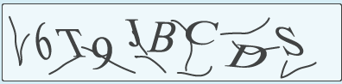
CODE AND CULTURE
Case Study
Pronouns
First Name
Last Name
Date of Birth
Phone No.
### ### ###
Security Check
Type the text here
Submit

Slide 39

CODE AND CULTURE
Case Study
Pronouns
First Name
**First Name too short
Last Name
**special characters not allowed
Li
Chan Mei
He/His
She/Her
Date of Birth
Phone No.
**exchange code cannot be empty
03/02/1999
+91
### ### ###
Security Check
Type the text here
Submit

Slide 40
Mitigating Bias
Innovation
&
Diverse Perspective
A11y Overlap,
More Traffic
SEO-friendly
Broader Adoption,
Higher Engagement
Broader Functionality,
Competitive Edge

Slide 41
CODE AND CULTURE
Global disability market represents $8 trillion^{[8]}
19% Increase in Revenue^{[9]}
78% millennials and Gen z population prefer inclusive brands^{[10]}
Inclusive workplaces boost performance by 56%^{[11]}

Slide 42
CODE AND CULTURE
How can I bring Inclusion through my Code?
#include <inclusion.h>
Notes:
how can i add a layer of inclusion in tech?
Bing mindful, proactive measures, ARIA testing tools.

Slide 43
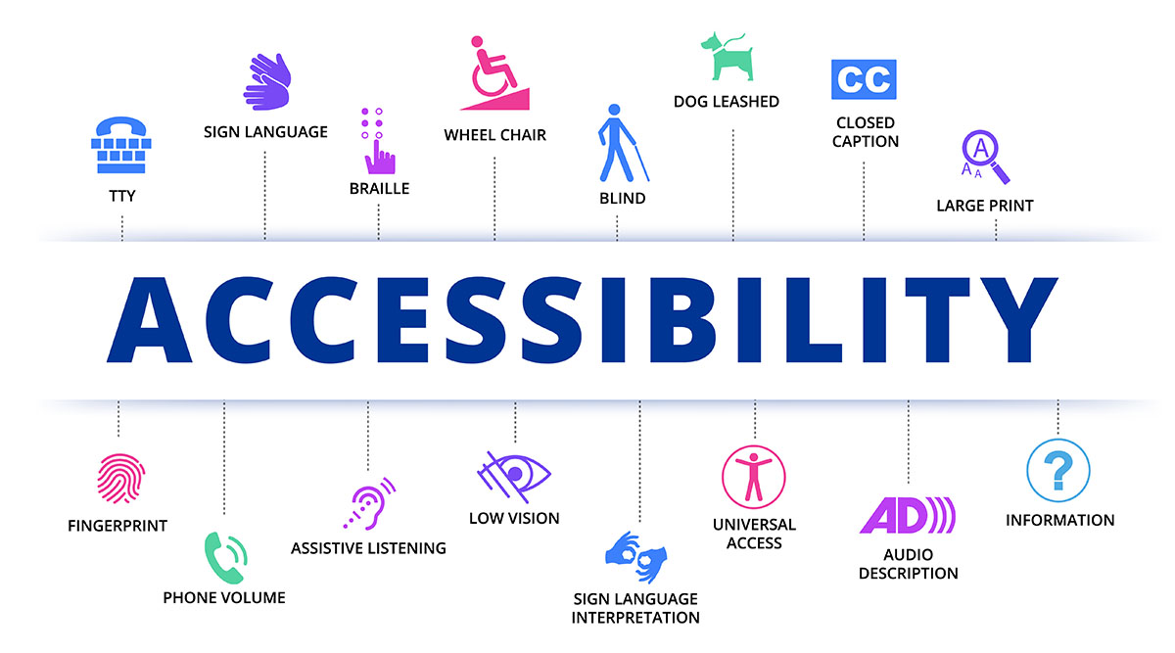

Slide 44
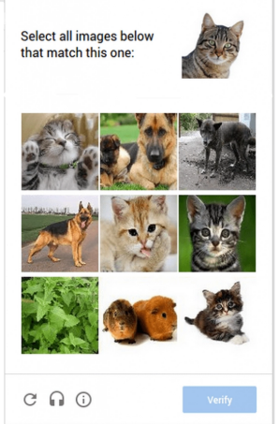
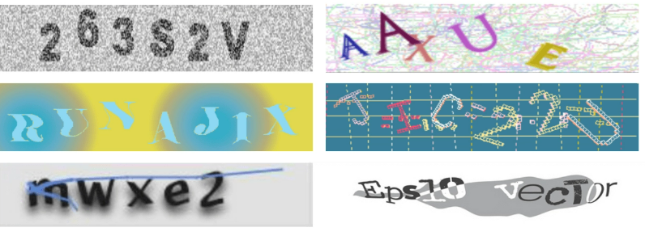
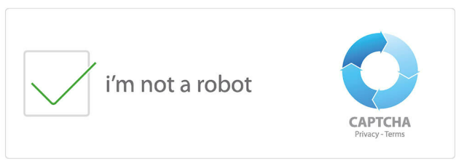
Implementing Authentication Security Protocols
Notes:
We all have interacted with security protocols in some way or the other. This particular example on the screen is to verify replay or impersonation attacks in general and we go with challenge response protocols like Captchas.
According to the World Health Organization (WHO), over 2.2 billion people worldwide have hearing loss, which is about 25% of the global population.

Slide 45
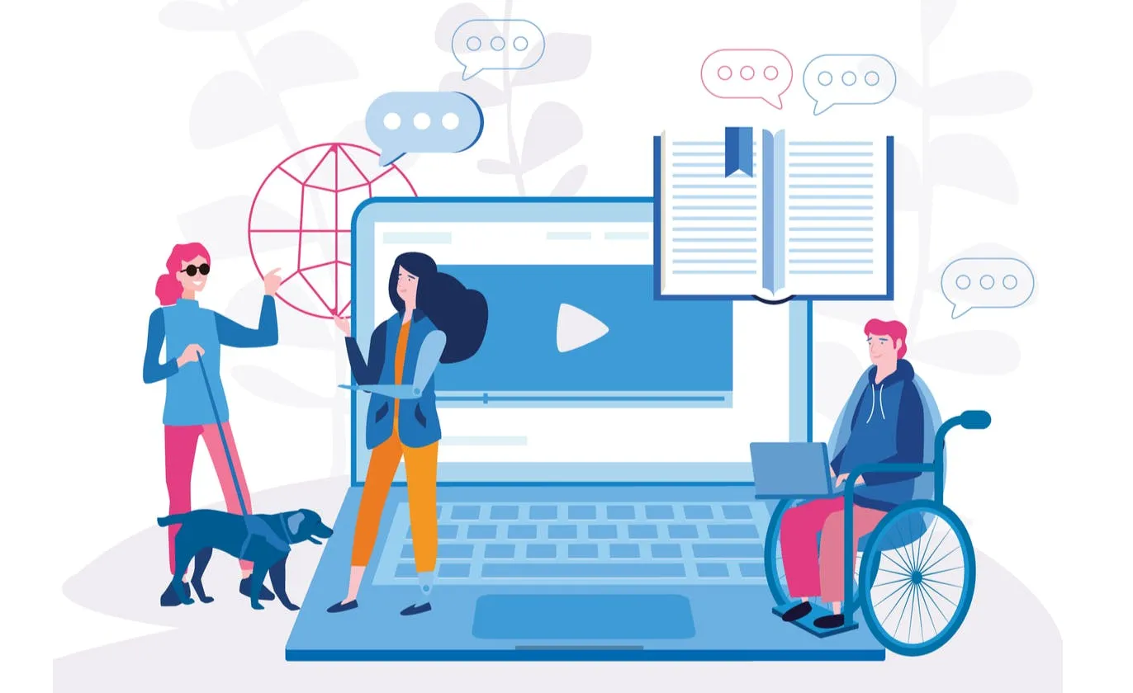
CODE AND CULTURE
Make it Keyboard Navigable
Provide text alternatives for media content
Incorporate assistive tech tools, like captions, text-to-speech, voice recognition, if needed.
Web Content Accessibility Guidelines (WCAG)
W3C Web Accessibility Initiative

Slide 46
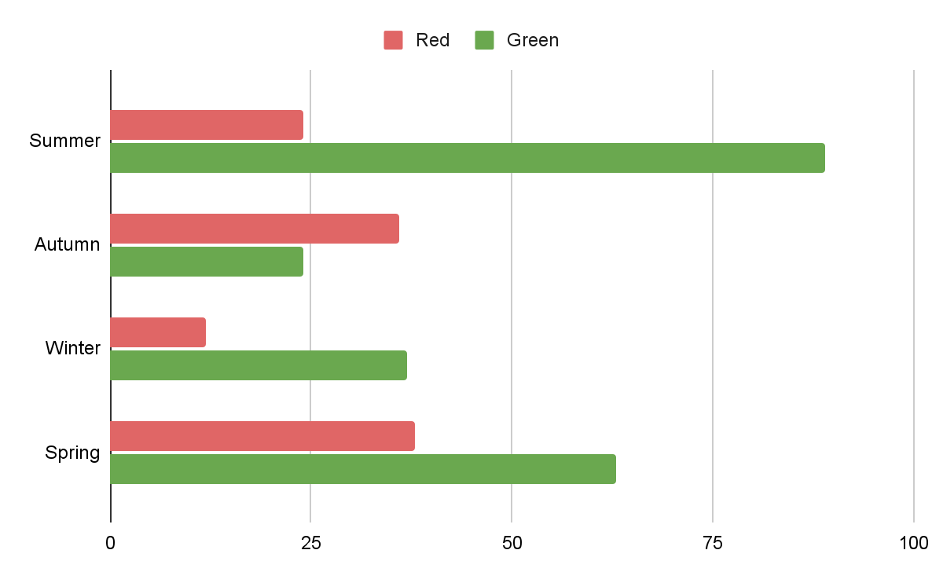
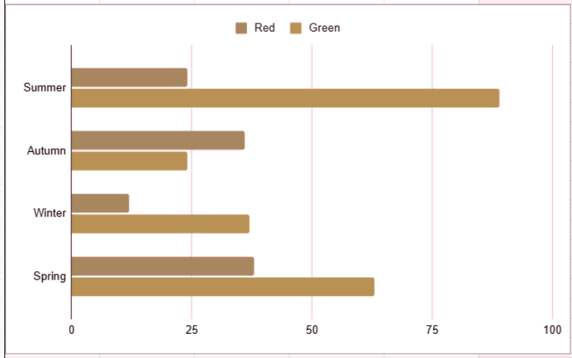
CODE AND CULTURE
Accessible Color Contrast
Bar chart to normal eyes
Same chart to Green-Red color blindness

Slide 47
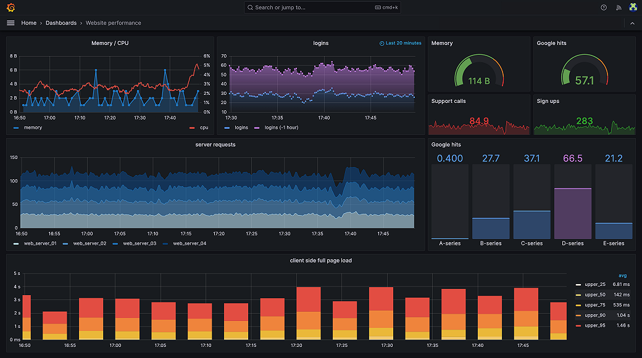

Slide 48

Do not edit
How to change the design
What's the most overlooked aspect of accessibility in tech?
Presenting with animations, GIFs or speaker notes? Enable our Chrome extension
Notes:
📣 This is Slido interaction slide, please don't delete it. ✅ Click on 'Present with Slido' and the poll will launch automatically when you get to this slide.

Slide 49
CODE AND CULTURE
"Building for accessibility ensures that no one is left behind due to physical or cognitive barriers”

Slide 50
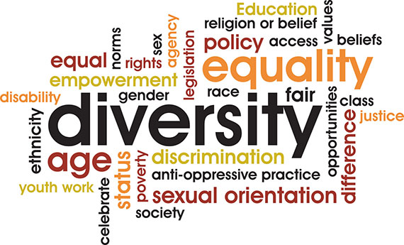

Slide 51
BIAS IN TECH PRODUCTS
Using training/testing with cultural bias.
Systemic barriers
Exclusionary Product Designs

Slide 52

Case Study: Snapchat’s Filter Controversy
A culturally diverse team helps avoid missteps that alienate or offend global users.

Slide 53
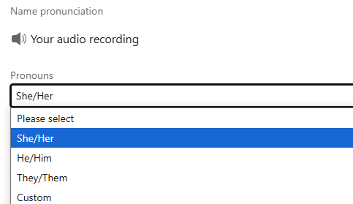
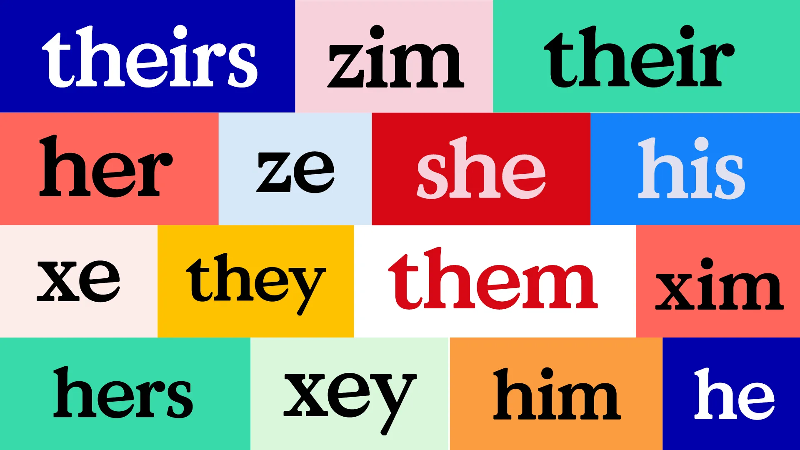
Case Study: Addition of They/Them Pronoun
“Clearly members want to feel empowered about how they self-identify” Bef Ayenew, Head of Engineering for Identity

Slide 54
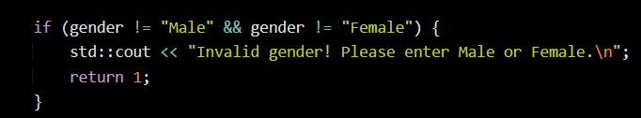
CODE AND CULTURE
Neglecting non-binary and gender-fluid users

Slide 55
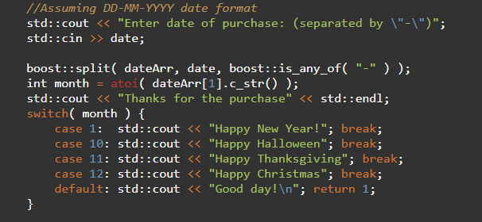
CODE AND CULTURE
Assuming non-global standards

Slide 56
CODE AND CULTURE
Neglecting other cultural holidays and traditions.

Slide 57


Slide 58
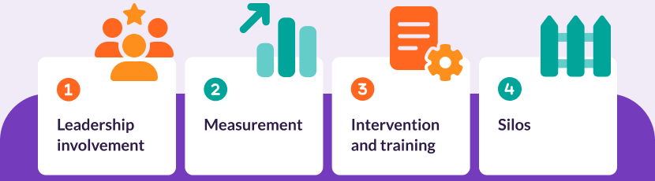
Diversity Beyond Numbers
Hiring Mindfully
Know your Audience
Respect &
belonging
Investing in D&I

Slide 59
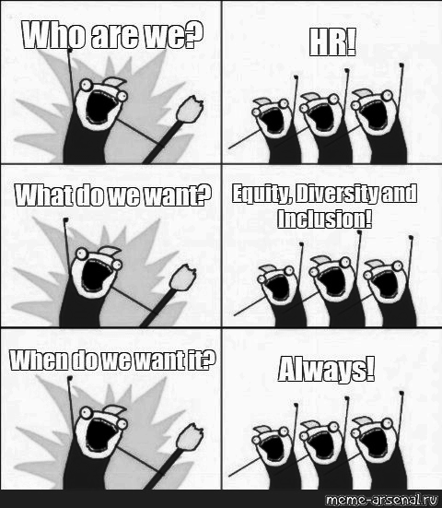

Slide 60

Diversity Beyond Numbers
So, you’re telling me...
Diversity and Inclusion improve overall tech community?
Well.. YES!!!

Slide 61
Diversity Beyond Numbers
“Equal job opportunities != INCLUSION.”

Slide 62
Diversity Beyond Numbers
“When we prioritize diversity, we’re not just building better technology; we’re building a more equitable future”

Slide 63
Diversity Beyond Numbers
“Inclusion is not an option - it’s essential for building tech that truly serves all.”

Slide 64
CODE AND CULTURE
[1] Sage Journal: https://journals.sagepub.com/doi/10.1177/17496020211037259
[2] WHO Report: https://www.who.int/health-topics/disability
[3] UNDRR 2023 Survey: https://www.undrr.org/report/2023-gobal-survey-report-on-persons-with-disabilities-and-disasters
[4] UNSECO 2023: https://www.unesco.org/en/articles/international-womens-day-new-factsheet-highlights-gender-disparities-innovation-and-technology
[5] Out Now Global: https://www.outnowconsulting.com/lgbt2020
[6] Eurostat: https://ec.europa.eu/eurostat
[7] ILO, 2023: https://www.ilo.org/publications/flagship-reports/world-employment-and-social-outlook-trends-2023

Slide 65
CODE AND CULTURE
[8] World Economic Forum: https://www.weforum.org/
[9] BCG Study: https://www.bcg.com/publications/2018/how-diverse-leadership-teams-boost-innovation
[10] Deloitte Survey:https://www.deloitte.com/global/en/issues/work/content/genz-millennialsurvey.html
[11] McKinsey & Company: https://www.mckinsey.com/featured-insights/diversity-and-inclusion/diversity-wins-how-inclusion-matters

Slide 66
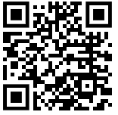
Let’s Gather Town!
Connect with me on LinkedIn: https://www.linkedin.com/in/sejal-gupta-she-her/
Or Use this QR Code

Slide 67
THANK YOU

